Slide 1

Analysis of NYC MVC Incidents
Data Courtesy of: NYC OpenData Initiative
DADM Group 2:
Nishana, Nick, Renee, Sarath

Slide 2

Contents
Dataset Background
Dataset Consolidation, Sorting, and Filtering
Underlying Question
Basic Data Analysis
Hypothesis Testing
Regression Model
Observations
Conclusions

Slide 3
Dataset Background
Dataset provided by NYC OpenData Initiative
Dataset contains Motor Vehicle Crash Data ranging from 2012 to 2020
Data is collected from NYPD MV104-AN report forms
This form is required to be filled out if the incident involves injury or death and/or $1000 or more of damages
Three separate datasets were generated from this data
MVC by incident
MVC by persons
MVC by Vehicle
Each set contained identifying keys that could be used to combine the data
Our final dataset consists of 25 Rows and 1.4 Million Columns

Slide 4
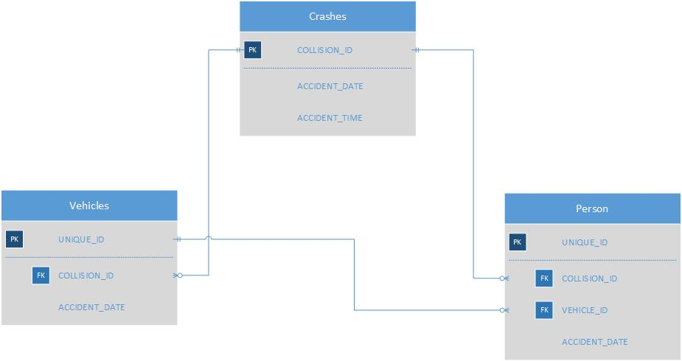
Dataset Consolidation, Sorting, and Filtering
We first used the database diagram on the left to connect crash location information from the “Crashes” and “Vehicles” Databases to the “Persons” Database which was our main dataset

Slide 5
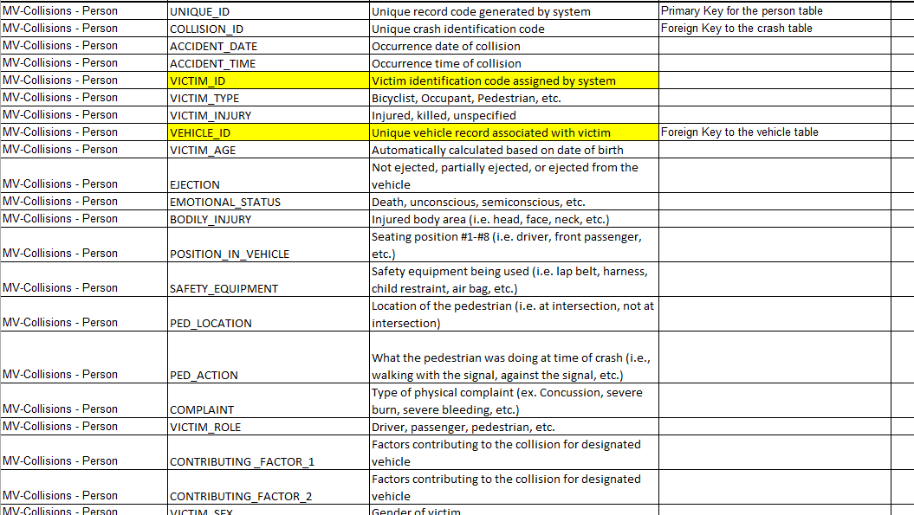
Dataset Consolidation, Sorting, and Filtering
Used the data dictionary to understand the meaning of each column
Used sort function to sort by COLLISION-ID then by ACCIDENT_DATE and then by ACCIDENT_TIME

Slide 6

Dataset Consolidation, Sorting, and Filtering
Filtered dataset to exclude columns that contained mostly incomplete or non-relevant data
Filtered out entries that were incomplete for key fields such as VEHICLE TYPE, SEX, etc.
Ended up with 119K Rows and 20 Columns

Slide 7
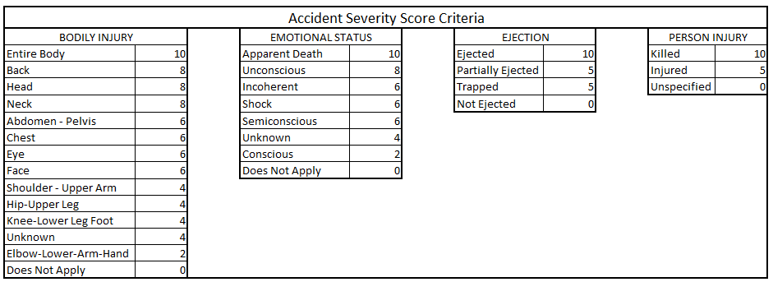
Calculated Accident Severity Score
Utilized a combination of categorical data points to calculate a cumulative “Severity Score” for each accident by assigning numerical values to describe the magnitude of severity based on the severity of each individual factor.
This method of scoring is loosely based off of the “Injury Severity Score” developed by the Association for the Advancement of Automotive Medicine.

Slide 8

Overall Question
What factors influence the severity of a motor vehicle accident in NYC?
Location
Age
Gender
Type of Vehicle
Safety Measures
Time
Date
Given these factors, can we create a model to predict accident severity?

Slide 9

Basic Data Analysis

Slide 10
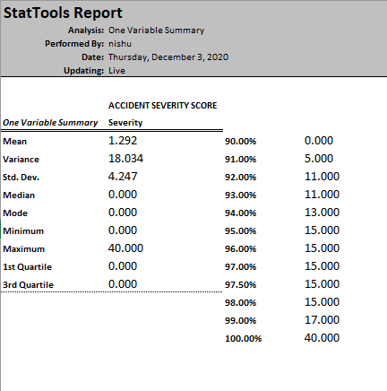
Statistical Summary: Accident Severity Score
The mean accident severity score among all accidents observed is 1.292
According to our scoring rubric, the mean accident severity in NYC results in no deaths, no bodily injury, no ejection from the vehicle, and has no effect on overall of the party(s) involved
Over 90% of accidents have a score of 0
Although there are numerous accidents per year in NYC, the vast majority are not severe

Slide 11
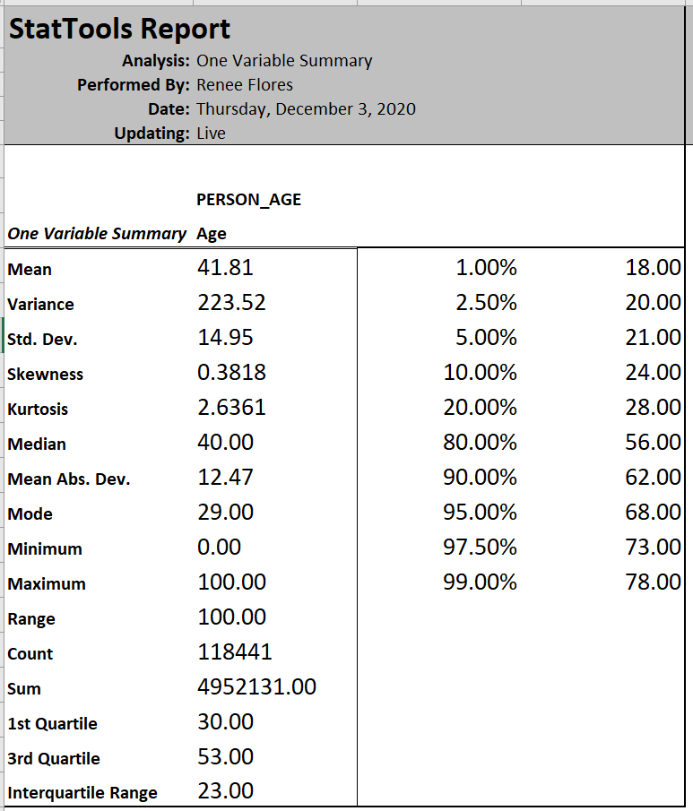
Statistical Summary: Age
99% of the dataset population is over the age of 18
This makes sense as 17-18 is the minimum driving age
80% of the dataset population is under the age of 56
As people get older they drive less often

Slide 12
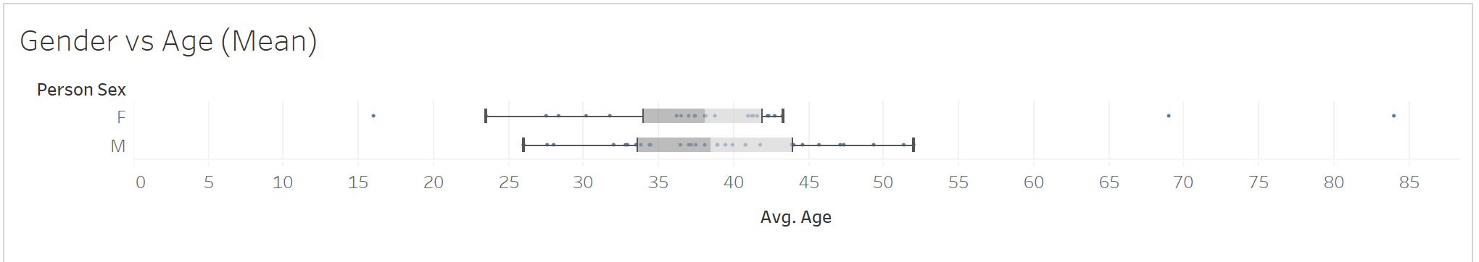
Statistical Summary: Gender & Age
The IQR for Age of Males involved in accidents is wider than that of Females
The Age Range of Males involved in accidents is wider and older than that of Females
The Mean Age for Males involved in accidents is slightly higher than that of Females

Slide 13
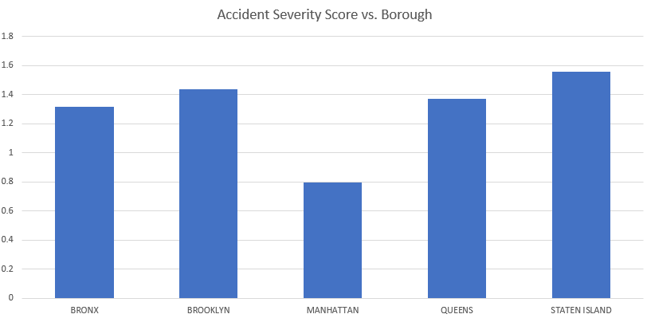
Accident Severity vs. Borough
Manhattan has a noticeably lower average severity score
This could be because traffic patterns in Manhattan prevent drivers from going fast enough to cause serious injury - mostly fender benders
The other boroughs are much closer to average

Slide 14

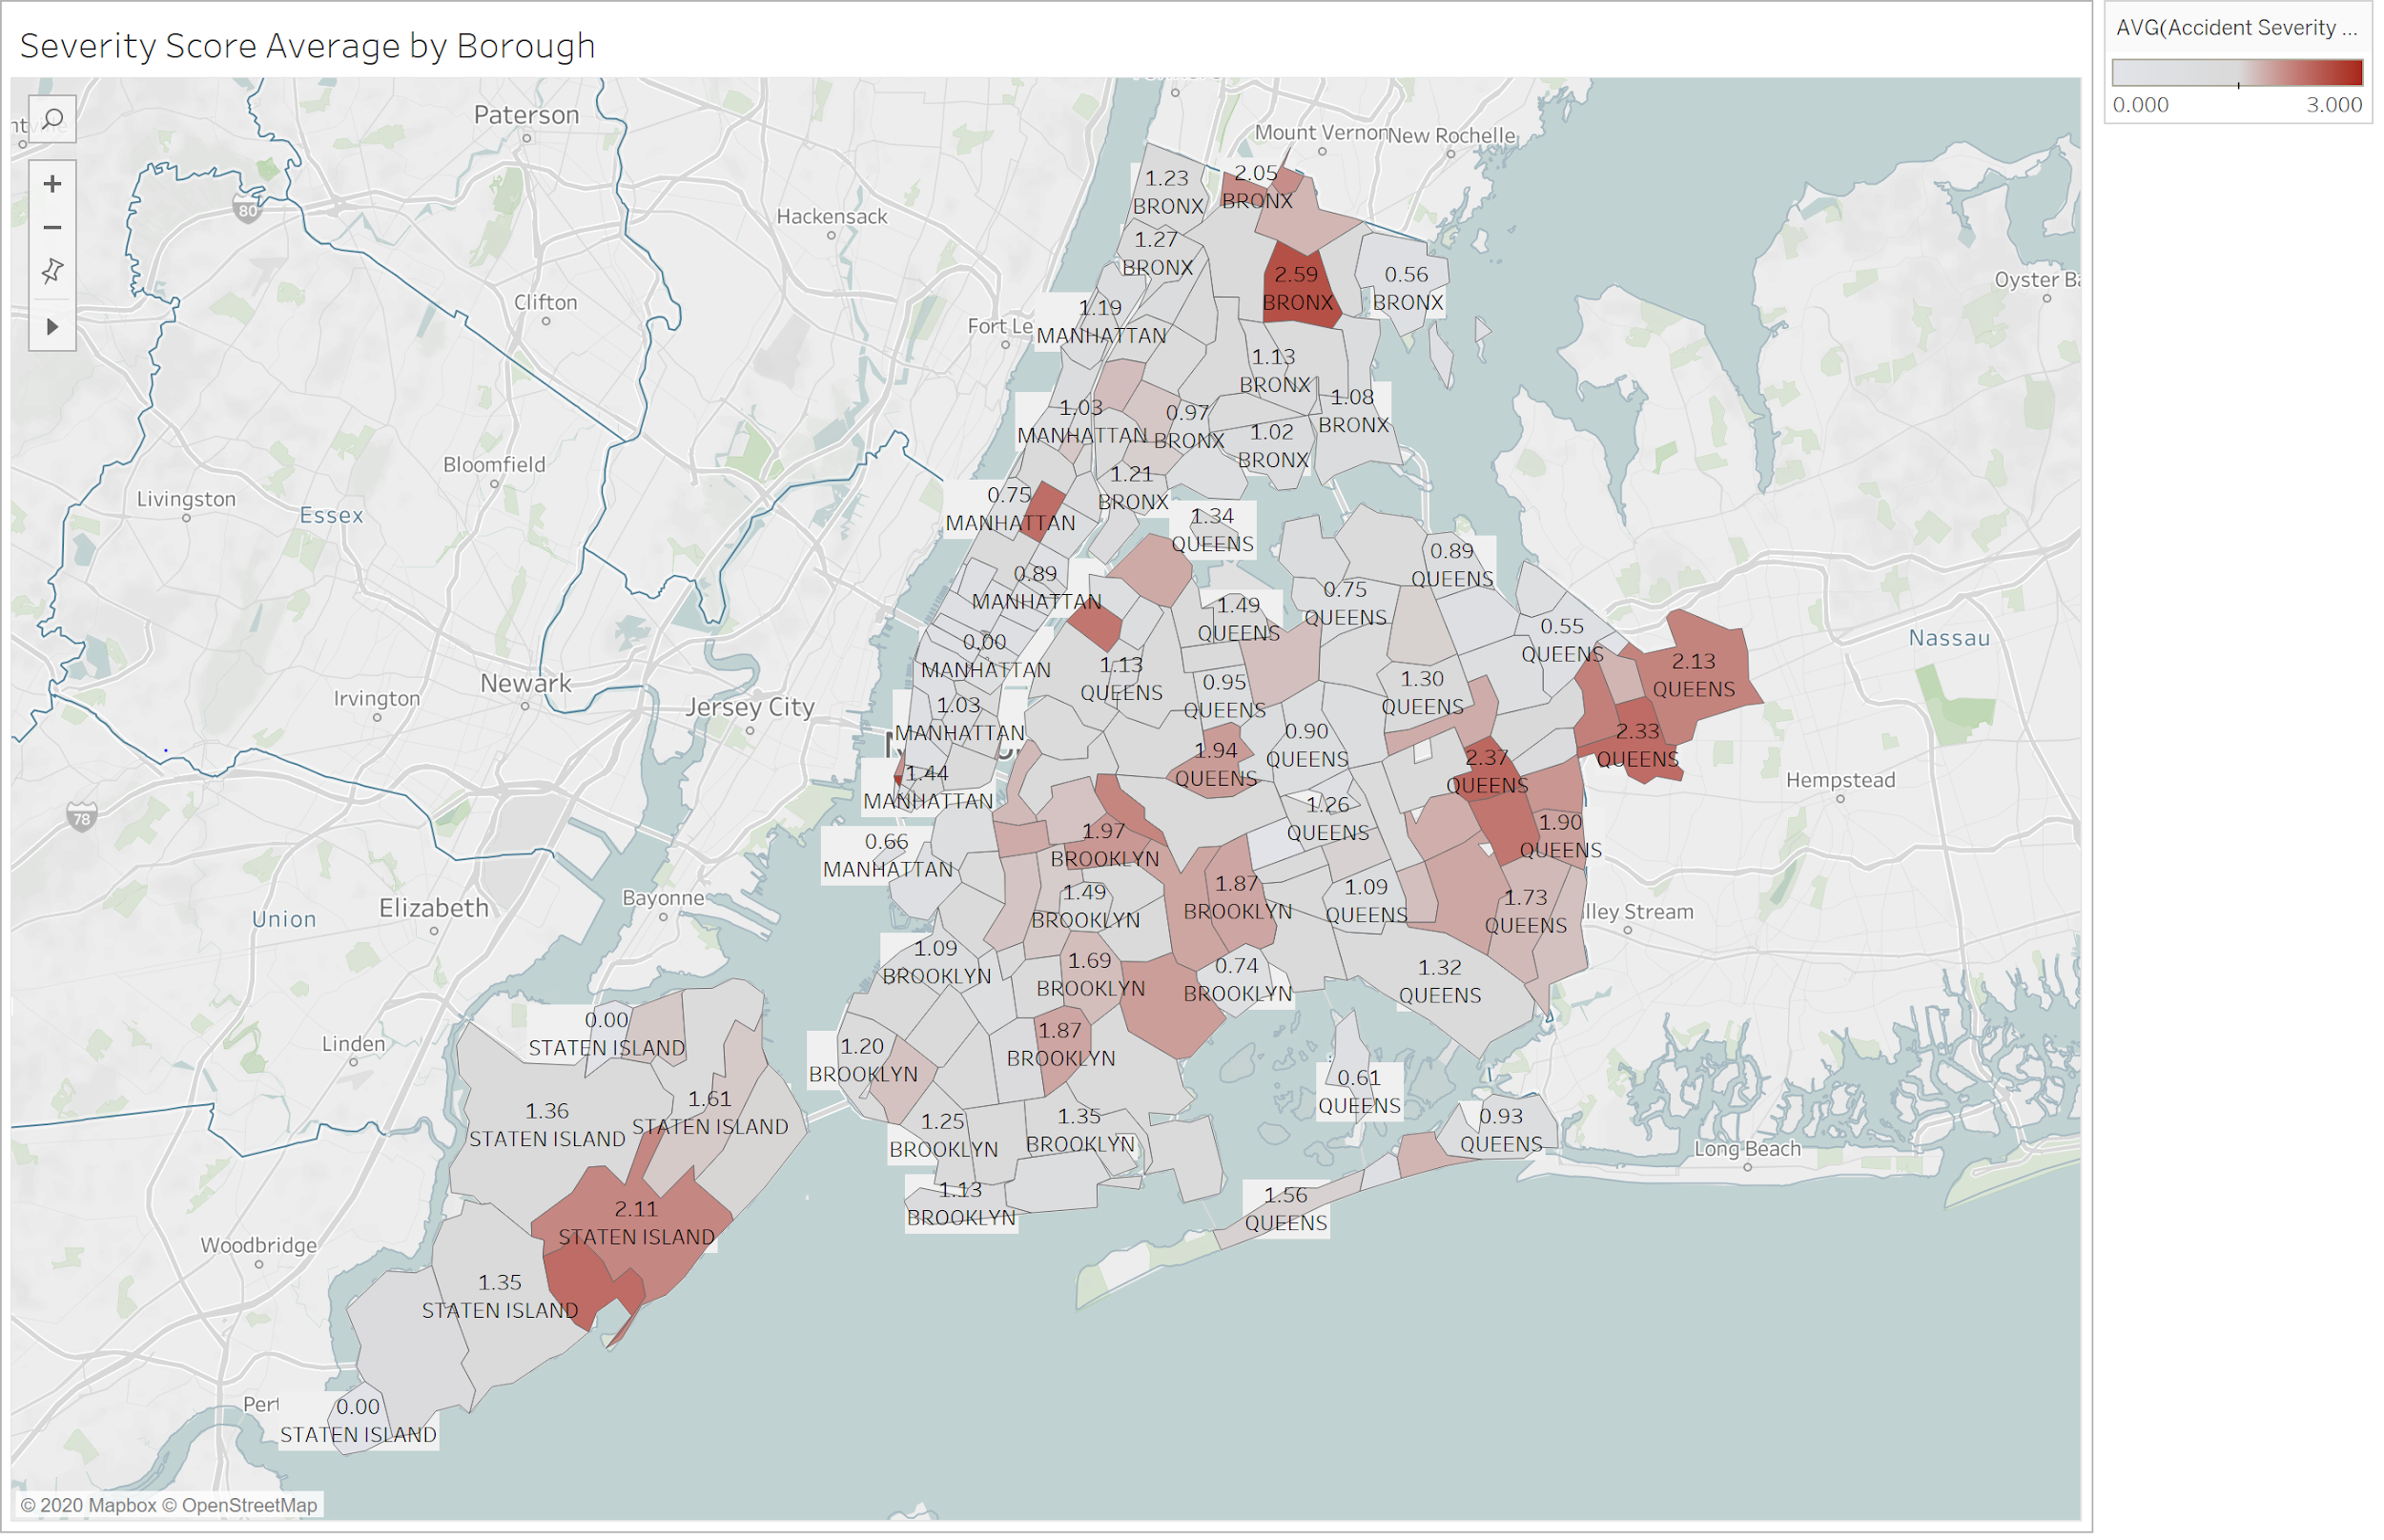
Accident Severity vs. Borough visualization
Of the 5 boroughs, the most severe accidents happen in the Bronx, followed by Queens, Staten Island, and Brooklyn
Manhattan has a noticeably lower average severity score than the other 4 boroughs

Slide 15
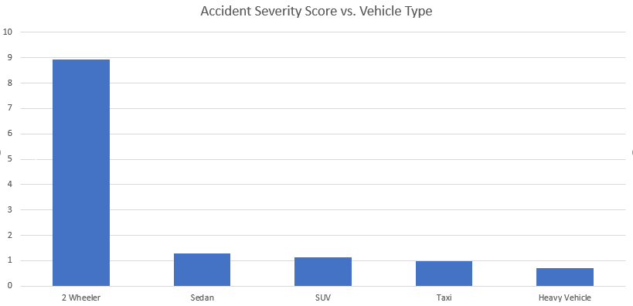
Accident Severity vs. Vehicle Type
2 Wheelers are significantly more susceptible to severe accidents
We know this to be true as motorcycles, bicycles and scooters offer little to no protection to their riders
Amongst the other vehicles, heavy vehicles protect their occupants slightly better

Slide 16
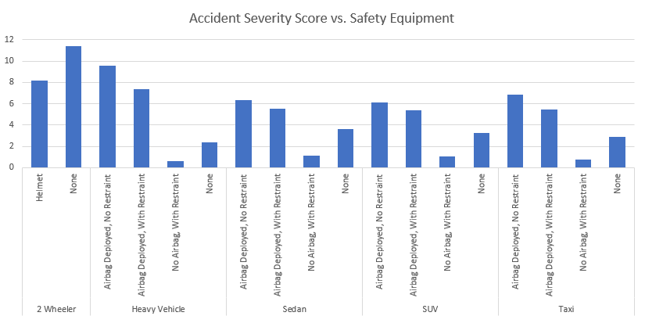
Accident Severity vs. Safety Measures
Across all vehicle classes we see that accidents in which airbags are deployed are more serious than those that do not
Accidents in which there is no airbag deployment and restraints are worn are the least severe
2 Wheeler accidents are severe even with a helmet

Slide 17
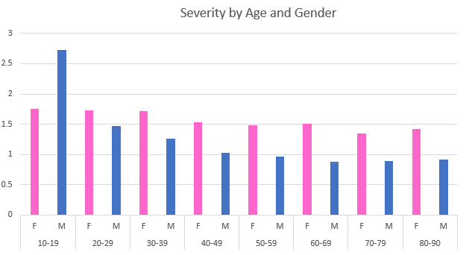
Accident Severity vs. Age & Gender
Males age 10-19 have a noticeably higher severity score
As age increases, the average severity score of males involved in motor vehicle accidents decreases more rapidly compared to their female counterparts of the same age
Accident severity score for females is relatively stable throughout the course of their lives

Slide 18
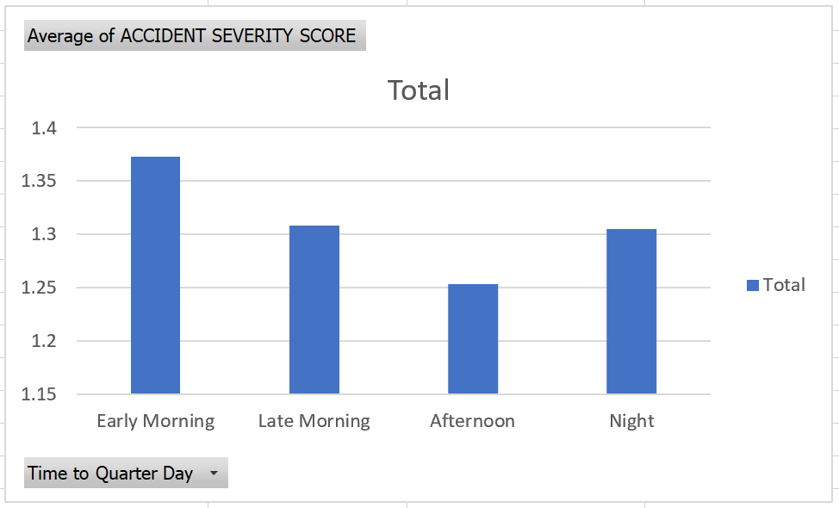
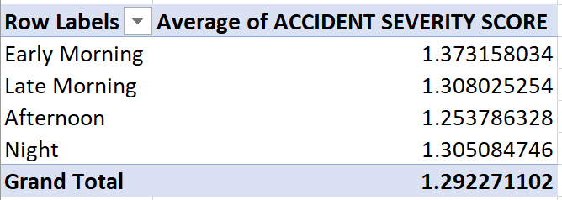
Accident Severity vs. Time of Day (6 Hour Intervals)
Accident Severity tends to be the highest in the early morning, and lowest in the afternoon
Overall difference in Accident severity across parts of the day is relatively small as compared to other factors

Slide 19
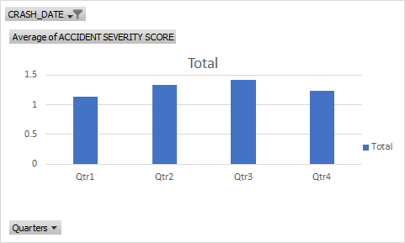
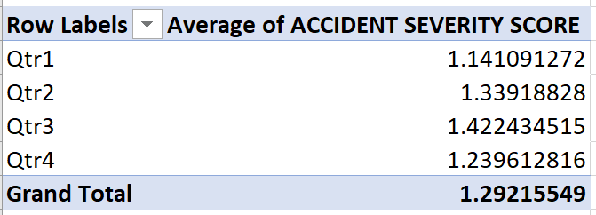
Accident Severity vs. Date (Quarterly)
Accident Severity tends to be the highest in Q3 and lowest in Q1
Overall difference in Accident severity across quarters is relatively small as compared to other factors

Slide 20


Hypothesis Testing

Slide 21
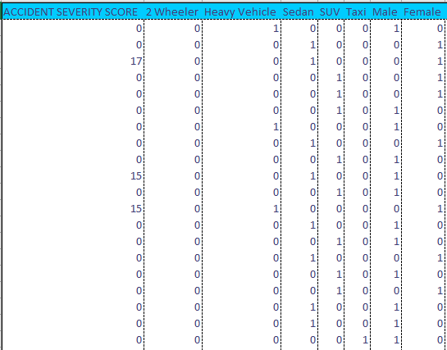
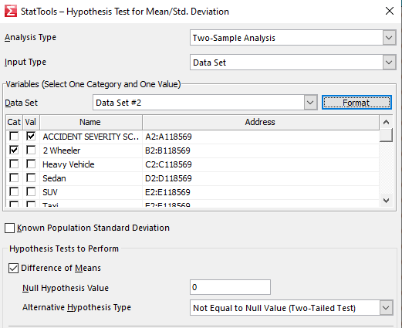
Hypothesis Testing Analysis
In this section we will display the results of our hypothesis testing analysis wherein we are attempting to understand which of the previously listed factors have a significant impact on the Accident Severity Score
To do this we used StatTools to conduct a series of Two Sample Hypothesis Tests wherein we converted our categorical data to dummy variables 0 and 1
We took this dummy data and conducted a Difference of Means analysis to find which factors had statistically significant impact on the Severity Score

Slide 22
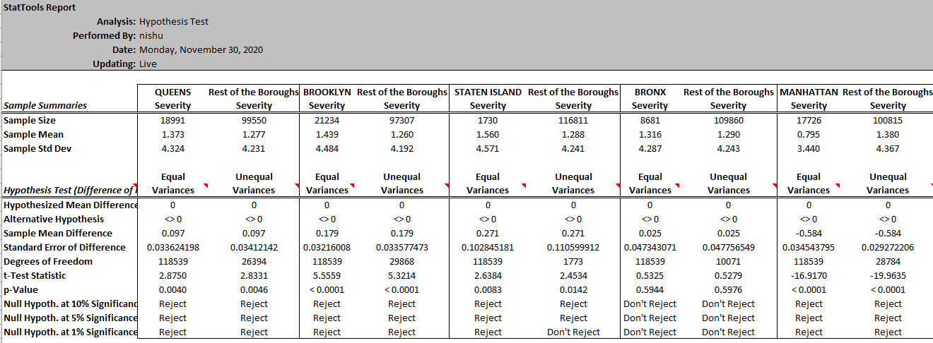
Hypothesis Test: Borough vs Severity

Slide 23
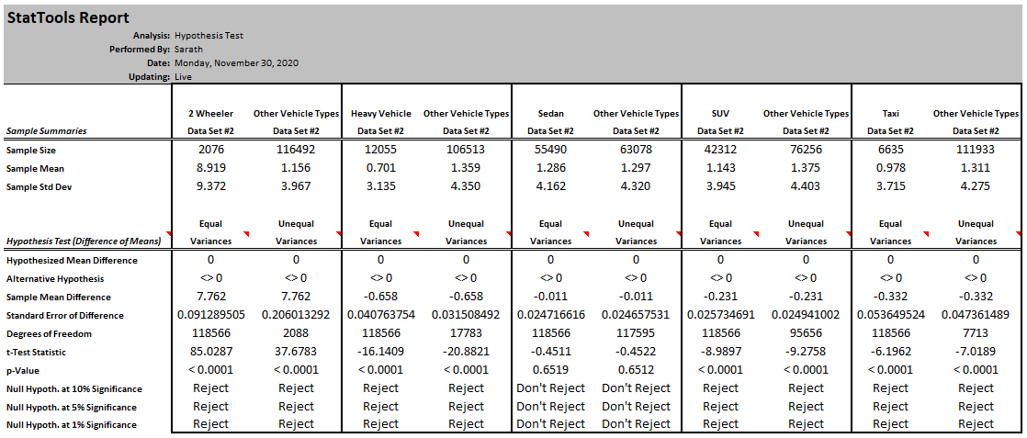
Hypothesis Test: Vehicle Type vs Severity

Slide 24
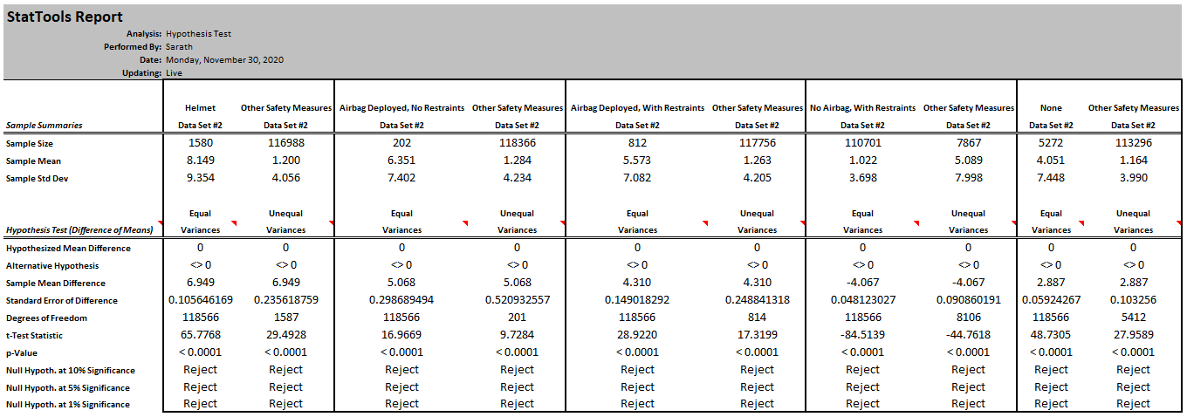
Hypothesis Test: Safety Measure vs Severity

Slide 25
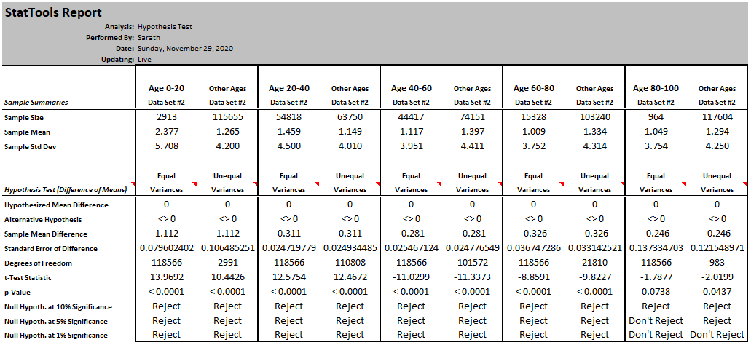
Hypothesis Test: Age vs Severity

Slide 26
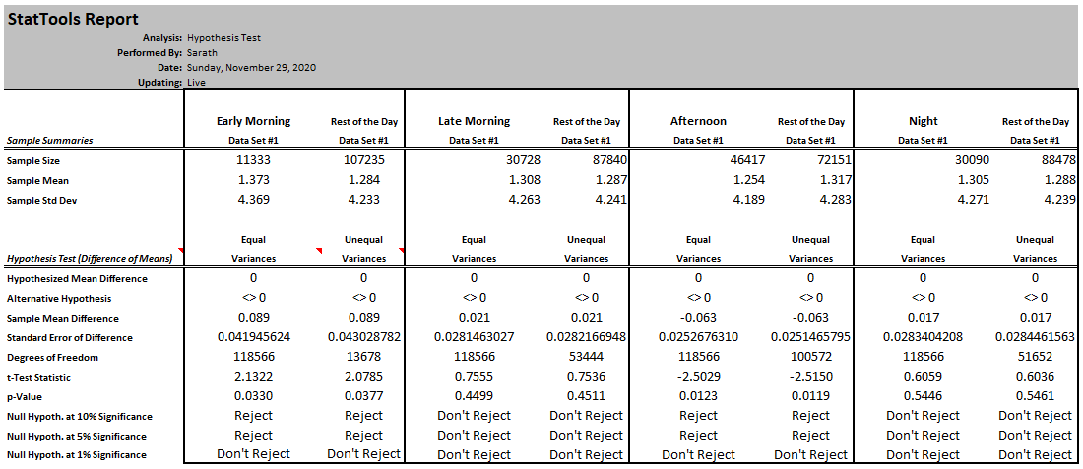
Hypothesis Test: Time of Day vs. Severity

Slide 27
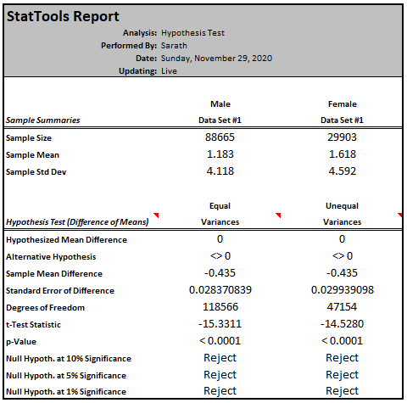
Hypothesis Test: Gender vs Accident Severity

Slide 28
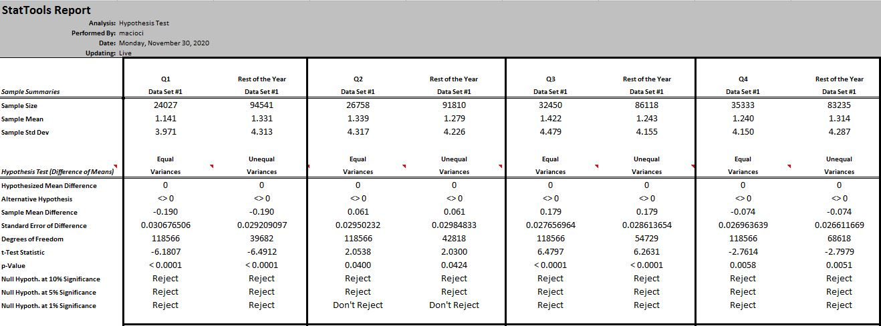
Hypothesis Test: Date vs Severity

Slide 29

Regression Model

Slide 30
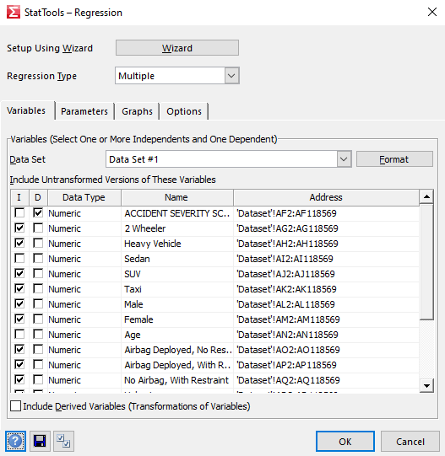
Regression Model Development
In this section we will display the regression model that we created using a StatTools Multiple Variable Regression
We chose to include any variables that had statistical significance at a 1% level of confidence from our hypothesis testing
Once we developed the regression model we used the calculated coefficients to create a calculator in Excel that allows the user to input Risk Factors and receive an estimated Accident Severity Score
This calculator is simply a user friendly application of the Regression Equation wherein each categorical variable receives a value of 1 or 0 based on the Risk Factor

Slide 31
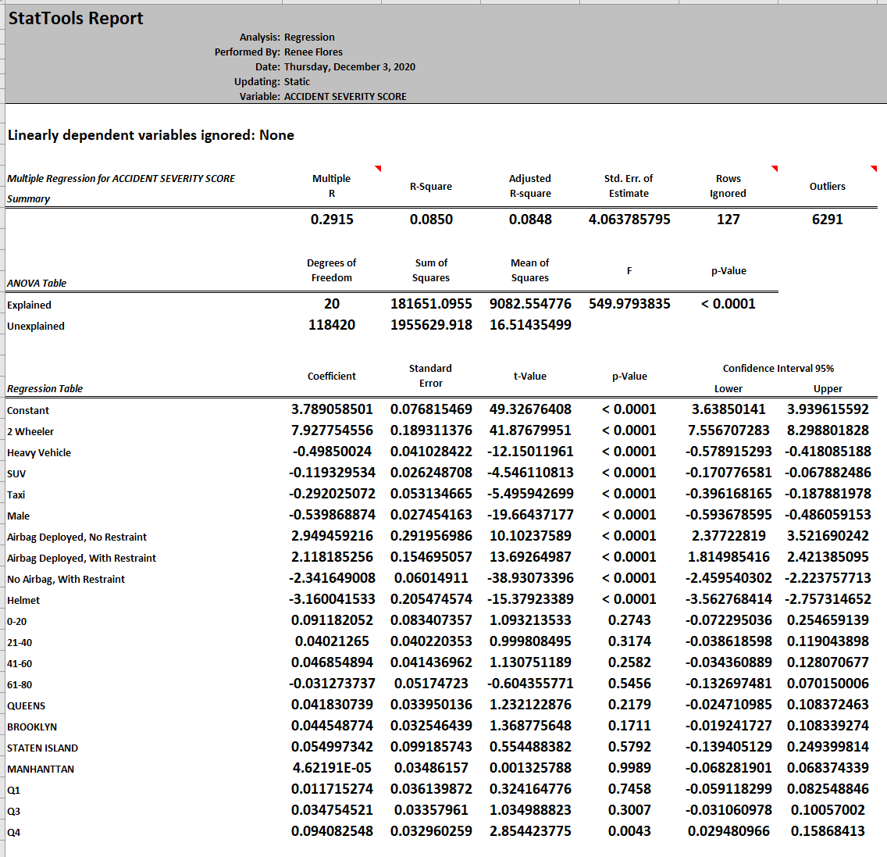
Regression Analysis
Regression Analysis created using a StatTools Multiple Variable.
We included any variables that had statistical significance at a 1% level of confidence from our hypothesis testing.
Looking at the results we see that despite the hypothesis testing telling us that several variables had statistical significance, we see here high p-Values

Slide 32
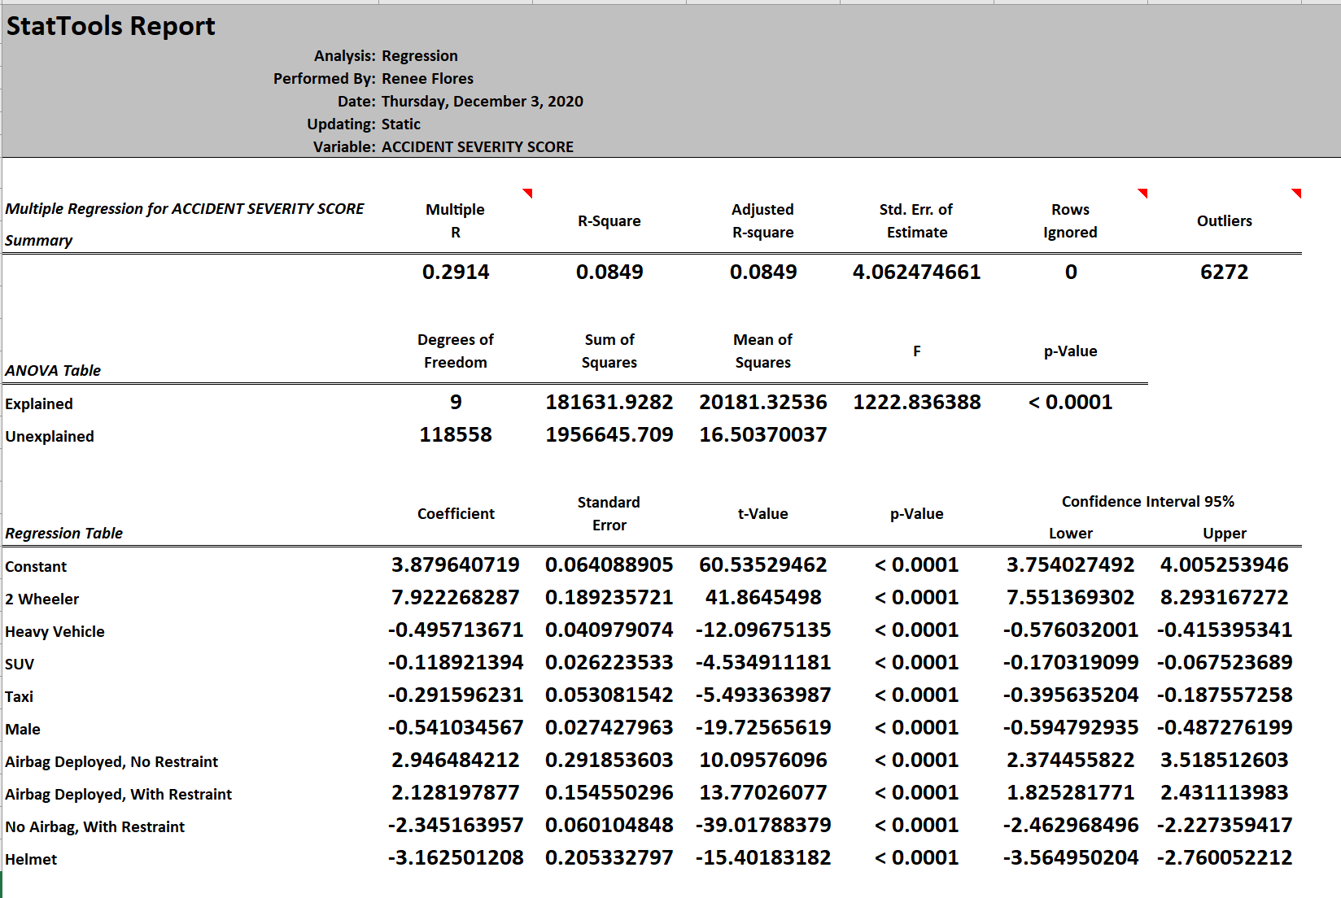
Regression Analysis Further Optimized
To further iterate on our regression model we decided run another regression wherein we removed any variables from the previous iteration with a high p-Value
Here we can see that all remaining p-Values are very low

Slide 33
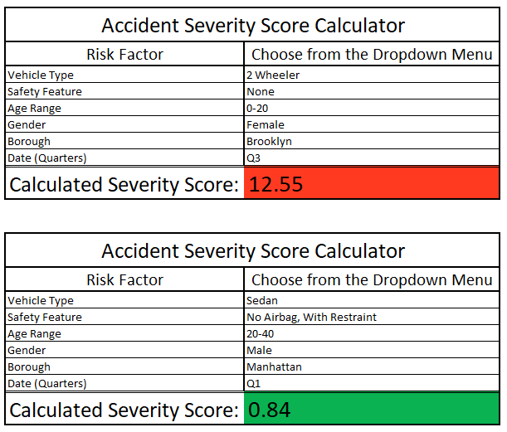
Regression Model: Severity Score Calculator
We created this calculator to allow us to test our regression model
It accepts user inputs via dropdown menu and then uses the coefficients from the regression model to derive the estimated Severity Score
As we can see even with the most severe risk factors the score will max out <15
Scores will typically be biased towards the lower end

Slide 34
Conclusions
90% of all accidents in NYC do not result in injury
The risk factors that most greatly impact the severity of an accident are the type of vehicle you are driving and what safety measures you are taking
Driving a 2-wheeler significantly increases your risk of being involved in a severe accident
but wearing a helmet while doing so reduces your risk significantly
Males under the age of 20 get into the most severe accidents, but females have a higher overall average accident severity score than males
Age, Borough, TOD, and Date have very marginal impacts on your overall risk factors of being in a severe accident.

Slide 35
Limitations
Several restrictions on the types of analysis we could do.
Data was largely categorical and dummy variables needed.
Due to inaccuracies and omissions from original reports there was missing data.
90% of accidents had a severity score of 0 making data biased in one direction.
We can infer that due to volume of traffic in NYC accidents would be quite common, but likely only “fender benders.”
Our model accurately represents that if involved in an accident in NYC the accident would typically not be severe.
We had no way to relate the context of this data to the total volume of driving in NYC, we cannot comment on an individual's likelihood of being in an accident, simply the fact that it will likely not be severe.

Slide 36
References
https://data.cityofnewyork.us/Public-Safety/Motor-Vehicle-Collisions-Crashes/h9gi-nx95
https://data.cityofnewyork.us/Public-Safety/Motor-Vehicle-Collisions-Person/f55k-p6yu
https://data.cityofnewyork.us/Public-Safety/Motor-Vehicle-Collisions-Vehicles/bm4k-52h4
https://aci.health.nsw.gov.au/get-involved/institute-of-trauma-and-injury-management/Data/injury-scoring/injury_severity_score

